Slide 1
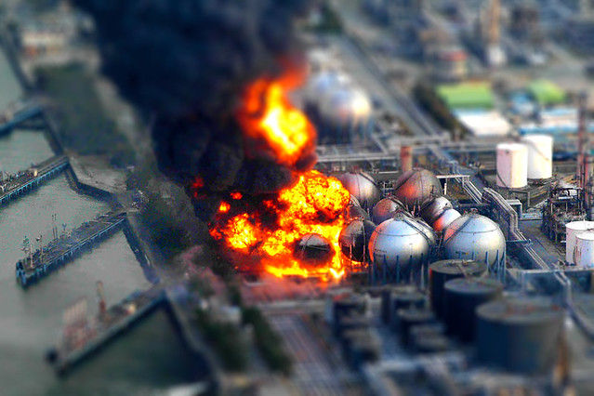
ENGG404 2022S: Welcome to the Kick-off Lecture
“Risk: Something bad could happen.”
“Leadership in Risk Management:
Lead your (future) organization in a way to prevent something bad from happening.”

Slide 2
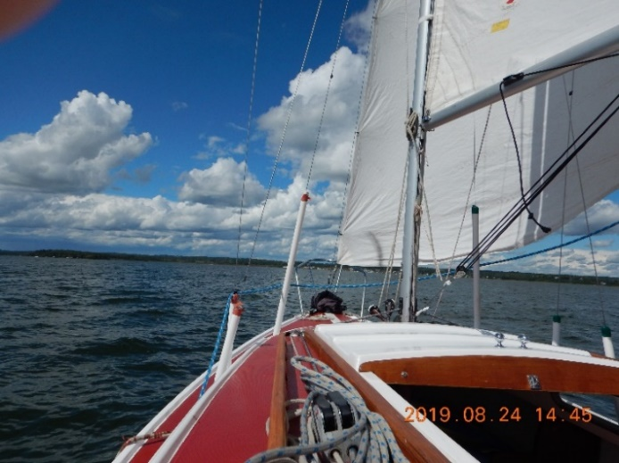
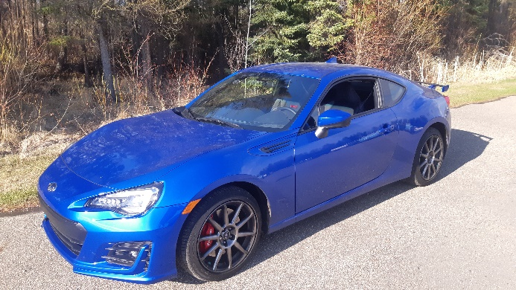
Professor Cocchio, P.Eng.
Education:
Bachelor of Applied Science in Chemical Engineering
Master of Business Administration
Innumerable “certificates”
Experience:
More than 32 years in the industry
Since “Day 1” (’79), process safety and
occupational safety responsibilities
One company – countless cultures.
Several world-scale petrochemical
plants.
In my spare time:
I sail …
I (try to) race …

Slide 3


Professor Cocchio, P.Eng.
Academic career: The U of Alberta since 2012
Industrial career: One Company, Dow Chemical Canada
No exotic, foreign, or glamourous locations though …
“The True North – Strong and Free”

